Slide 1
Time Complexity Analysis

Slide 2
Purpose
Measure the time taken by programs
Compare two or more solutions to a problem – for their speed
Categorise a program into one of the known categories of time complexities

Slide 3
(Type of) Problem(s) to be solved
double power(int x, int y) {
long long prod = 1;
int i;
long long term = x;
if(y < 0) {
sign = -1;
y = -y;
}
for(i = 0; i < y; i++)
prod = prod * x;
if(sign == -1)
prod = 1.0 / prod;
return prod;
}
double power(int x, int y) {
long long ans = 1;
long long term = x;
while(y > 0) {
if(y % 2 == 1)
ans *= term;
term = term * term;
y = y/2;
}
return ans;
}
Question: Which solution is better? How much better? How ‘good’ is each solution?

Slide 4
Measuring the ACTUAL
Time taken by a program

Slide 5
time ( ) function
The time( ) function gives you the current time in a program
SYNOPSIS
#include <time.h>
time_t time(time_t *t);
DESCRIPTION
time() returns the time as the number of seconds since the Epoch, 1970-01-01 00:00:00 +0000 (UTC).

Slide 6
time ( ) function
Original code
int main() {
f();
g();
h();
}
Modified code
int main() {
time_t t1, t2, time_taken;
t1 = time();
f();
g();
h();
t2 = time();
time_taken = t2-t1;
}
You can use time( ) function like this in your program to measure time taken by the program

Slide 7
time ( ) function
Limitations
  The original program is modified, so it's no longer the same program
  The time obtained includes the time spent in waiting for user input, output and other I/O also
    Suppose the user enters the data for a getchar() after 1 hour, then the 1 hour is also included in the time

Slide 8
gettimeofday() function
The time( ) function returns time in seconds
  This may not be useful for programs which run in less time
The gettimeofday() function returns time in microseconds
  It can be used in the same fashion as the time( ) function

Slide 9
The “time” command
You can run any program preceded with the “time” command:
For example, run
  time ls
It will show three timings in the end like this:
  real 0m0.001s
  user 0m0.000s
  sys 0m0.000s

Slide 10
$ time ./a.out
real 0m0.003s
user 0m0.001s
sys 0m0.002s

Slide 11
The “time” command
The meaning of the three timings shown
Real
  This is the total time taken by the program to run, includes the waiting time involves in I/O also
User
  The actual CPU time taken by the program
    This is the time we are normally interested in
Sys
  Time taken by the user program + time taken by the OS

Slide 12
Use the time command
You should use the time command to run your own programs
  Use it like this
  time ./program arg1 arg2 arg3
The user timings should be noted down
If the user timing is 0.000s then it means your input size was too low, give a bigger sized input to your program

Slide 13
Limitations of “measuring actual time”
Needs a running program to begin with
  Can't do it with the “idea” of the program, the algorithm
  Most of the times we want to discard the idea for a better idea, and write code only for the better idea
Gives the measure of time for a specific input only
  Can't tell me in general how the program behaves
    This is what we normally want. Know how efficient the program is for any input in general
  We can plot a graph of time taken for various inputs to get some idea of the “general” behaviour of “time taken”

Slide 14
Time Complexity Analysis

Slide 15
Time complexity Analysis
Normally involves two steps
Deriving an algebraic equation for the time taken by the program
    Sometimes we derive three equations: Best case, Average case, Worst Case
    Most of the times the Worst case is sufficient
    May be difficult for programs which are complicated
Deriving an lower/upper/tight bound on the equation found
    Finding a (known) equation, which is better or worse than the equation at hands

Slide 16
Deriving time taken by a program
Consider this program
int main() {
int x = 10, y = 20, z;
z = x + y;
y = z * x;
return 0;
}
What is the time taken by this program?
How do we measure the time taken by a program algebraically?
  Algebraic formula will give the “general” notion about time taken

Slide 17
Run time not required for ...
Your code is comprised of many “parts”
Some parts of your code are only for the use of compiler
  No machine code is generated for them
  No memory is allocated for them
  They don't consume run-time
Parts of code which “don't run”
  #include
  #define and all # directives
  typedefs
  prototype declarations
  Type declarations like struct, union
  Keywords: if, else, while, for, main, ... etc.

Slide 18
Run time is required for ...
Time is required, at run-time for only some parts
  Parts which actually get converted into machine code and some machine code runs for them when the program is running
  Calling a function
    int f(int y) { .... }; f(2);
    The call f(2); requires time
  Allocating local variables and function arguments
    f(int x, int y) { int m; }
    Allocating memory for x, y, m;
  All operations (i.e. use of operators)
    +, -, *, / ,...., = , ==, <=, ... , return,
  return

Slide 19
Deriving time taken by a program
Consider this program
int main() {
int x = 10, y = 20, z;
z = x + y;
y = z * x;
return 0;
}
What is the time taken by this program?
How do we measure the time taken by a program algebraically?
  Algebraic formula will give the “general” notion about time taken

Slide 20
Time Taken by a program
Time taken by a program = Sum of time taken by all it’s parts
When we say, constant time: typically some nanoseconds
  On faster CPUs e.g. 2GHz vs 1GHz, it may be less
  For example a multiplication will typically be faster on a 2GHz processsor than a 1GHz processor
Time taken by various parts
  Operations: some constant time
    Every operation gets converted into a fixed no. of machine instructions, so it takes some constant time while running
      Different operations have different constants. Multiplication and division take a LONG time, while bitwise operations often take a very small time
  Function call, return: another constant time
  Allocating local variables, arguments: constant time (no matter how many of them)

Slide 21
Deriving time taken by a program
Consider this program
int main() {
int x = 10, y = 20, z;
z = x + y;
y = z * x;
return 0;
}
Time taken = sum of time taken by various parts
Here all parts take some constant times
  4 ‘=’ operations
  One + operation
  One * operation
  One return
  One variable allocation
  So, total, The program takes some constant time
time_taken( ) = C

Slide 22
Deriving time taken by a program
Time taken = sum of time taken by various parts
Time taken = Sum of
  4 = operations
  One function call f()
  One return
  Variable allocation for main( )
  Time taken by f ( ) function
    One + operation
    One return operation
    Variable allocation
All the above times are some constants
So program takes consant time
time_taken( ) = C
Consider this program
int f(int p, int q) {
return p + q;
}
int main() {
int x = 10, y = 20, z;
z = f(x, y)
y = z * x;
return 0;
}

Slide 23
Deriving time taken by a program
Consider this program
int f(int p, int q) {
return p + q;
}
int main() {
int x, y, z;
scanf(“%d%d”, &x, $y);
z = f(x, y)
y = z * x;
return 0;
}
Time taken = sum of time taken by various parts
Time taken = Sum of
  2 ‘=’ operations
  One function call f()
  One function call scanf()
  One return
  Variable allocation for main( )
  Time taken by f ( ) function
    One + operation
    One return operation
    Variable allocation
  Time taken by scanf() function
    Assume to be constant
    For library functions we NEED TO know their equation for time taken
All the above times are some constants
So program takes consant time
time_taken( ) = C

Slide 24
Deriving time taken by a program
Consider this program
int f(int p, int q) {
return p + q;
}
int main() {
int x, y, z = 10;
scanf(“%d”, &x);
for(y = 0; y < 10; y++)
z = f(x, y)
y = z * x;
return 0;
}
Time taken = sum of time taken by various parts
Time taken = Sum of
  Time taken by scanf() function
    Assume to be constant
  One ‘*’ operation (z * x)
  Two ‘=’ operation (z = 10, y = z * x)
  One ‘=’ operation (y =0)
  10 ‘=’ operations (z = f(x, y))
  11 ‘<’ operations (y < 10)
  10 ++ operations (y++)
  10 function calls f()
  10 * time required for f ()
    One return, one ‘+’ operation => Constant
  All the above timings and their sum is a constant
So program takes consant time
time_taken( ) = C

Slide 25
Deriving time taken by a program
Consider this program
int f(int p, int q) {
return p + q;
}
int main() {
int x, y, z = 10;
scanf(“%d”, &x);
for(y = 0; y < x; y++)
z = f(x, y)
y = z * x;
return 0;
}
Time taken = sum of time taken by various parts
Time taken = Sum of
  Time taken by scanf() function
    Assume to be constant
  Constant time operations
    One ‘*’ operation (z * x)
    Two ‘=’ operation (z = 10, y = z * x)
    One ‘=’ operation (y =0)
  Variable time operations
    x ‘=’ operations (z = f(x, y))
    x+1 ‘<’ operations (y < 10)
    x ++ operations (y++)
    x function calls f()
    x * time required for f ()
      One return, one ‘+’ operation => Constant
  T(X) = X * C1 + C2

Slide 26
Deriving time taken by a program
Time taken by scanf() function
  Assume to be constant
Constant time operations
  Z =10, k = 0, y = z* x;
Variable time operations
  x Runs of the loop for(i = 0) and k++
    Each run of the loop:
      One i = 0
      Y + 1 times i < y
      Y times i++
      Y times z =
      Y times f(x, y)
        Each time of f(x, y) is a constant
  X+1 times k < x
T(x, y) = c0 + x * (c4 + y * c2 + y * c1) + c3 + y * c2 + y * c1 + x * c5
T(x, y) = A + Pxy + Qx
Consider this program
int f(int p, int q) {
return p + q;
}
int main() {
int x, y, z = 10, k, i;
scanf(“%d%d”, &x, &y);
for(k = 0; k < x; k++)
for(i = 0; i < y; i++)
z = f(x, y)
y = z * x;
return 0;
}
C0
x * (c4 + y * c2 + y * c1 )
c3
y * c2
y * c1
x* c5

Slide 27
Deriving time taken by a program
Consider this program
int f(int p, int q) {
return p + q;
}
int main() {
int x, y, z = 10, k, i;
scanf(“%d%d”, &x, &y);
for(k = 0; k < x; k++)
for(i = 0; i < y; i++)
z = f(x, y)
y = z * x;
return 0;
}
Other way of derivation
Time taken by inner loop = Ay + B
Time taken by Outer loop = Time for k=0 + x * (Time taken by inner loop, k < x, k++)
  = P + x (Ay + B + C)
  = P + Qx + Axy
Time taken by Program = Const + P + Qx + Axy

Slide 28
Deriving time taken by a program
Solution-1 for the x^y problem
double power(int x, int y) {
long long prod = 1;
int i;
long long term = x;
if(y < 0) {
sign = -1;
y = -y;
}
for(i = 0; i < y; i++)
prod = prod * x;
if(sign == -1)
prod = 1.0 / prod;
return prod;
}
int main() {
int x, y;
scanf("%d%d", &x, &y);
printf("%lf\n", power(x, y));
return 0;
}
If{ } implies that some code may or may not run at times
  Such cases lead to 3 different analysis
  Best case – minimum possible time
  Worst case: Maximum possible time
  Average case: Average time, considering all cases
Let’s find the worst case time equation here
  In worst case the if() condition is true
  Time taken by for loop is Ay + B
  So time taken by Power function is
    Ay + B + C
  Time taken by Main() = Ay + B + C + D
main(y) = Ay + E

Slide 29
Deriving time taken by a program
Solution-1 for the x^y problem
double power(int x, int y) {
long long ans = 1;
long long term = x;
while(y > 0) {
if(y % 2 == 1)
ans *= term;
term = term * term;
y = y/2;
}
return ans;
}
int main() {
int x, y;
scanf("%d%d", &x, &y);
printf("%lf\n", power(x, y));
return 0;
}
Worst case time equation
power(y) = A * No. Of times the loop runs + B
  = A * (log2y + 1) + B
  = A * log2y + C
Why log2y?
  By definition log2x is number of times division by 2 is required to reduce the number x to 1

Slide 30
Comparing time taken by two equations
O, Ώ, Ɵ notations

Slide 31
Consider these two solutions to the power (x^y) problem
term = x *x
prod = 1
for(i = 0; i < y/2; i++)
prod = prod * term;
if(y %2)
Prod = prod * x;
Equation for time taken is
P(y) = A(y/2) + Q
Where
A: constatnt time required for i < y, i++, prod *x, prod =
Q: constant time required for i =0, prod = 1, term = x*x, y%2, prod = prod *x
prod = 1
for (i = 0; i < y; i++)
prod = prod * x
Equation for time taken is
T(y) = Ay + B
Where
A: constatnt time required for i < y, i++, prod *x, prod =
B: constant time required for i =0, prod = 1

Slide 32
Consider these two solutions to the power (x^y) problem
Here both equations are linear equations
The second equation has a smaller constant A/2 for the y term
The second equation has a bigger constant term Q (Q > B)
Still, we can say that the second one performs better for higher values of y ?

Slide 33
Comparing two linear solutions
Consider two linear equations
  T(y) = 2y + 4
  P(y) = 4y + 8
Clearly P(y) = 2 * T(y)
  This means solution P is twice as slow as solution T
Suppose we run P and T both on a 2 GHz
  Then P will take twice the time to run
Suppose we run P on a 2 GHz machine and T on a 1 GHz machine
  Then P and T will take same time to run
This reflects the dependence of the constant 4 in 4y (or 2 in 2y) on the speed of the processor
Equations of the same degree, can be made comparable by changing the processor (i.e. the constants)

Slide 34
Comparing two functions
Not of the same degree
Suppose Equation for time taken is
T(x) = 300x + 500
And another equation for time taken is
R(x) = 3x² + 5x
The constants 300 and 500 are (100 times) higher than the constants 3 and 5 in R(x)
What do we get when we plot the graphs of these two functions?

Slide 35
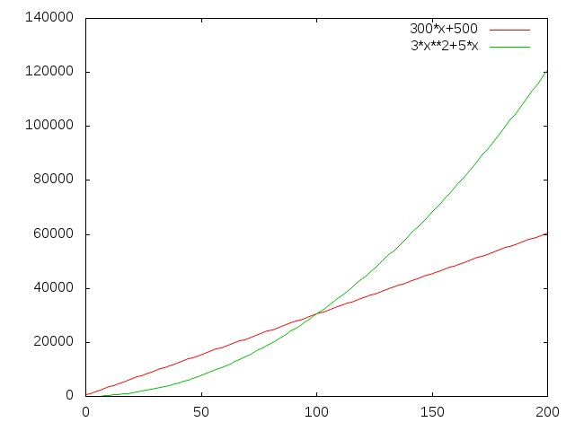
Comparing two functions
Not of the same degree
Here we find that even though the constants 300,500 are very high, after x = around 100, the green curve of 3x²+5x is always above the curve of 300x + 500
This is because as value of x grows, the term x² dominates the constant 3 or 300

Slide 36
Comparing two functions
Not of the same degree
Contrast the euqation
T(x) = 300x + 500
With
R(x) = 3x² + 5x
Can we make R(x) run as fast as T(x) if we can get as fast a processor as desired?
Looking at equations, we find that we’ll need a (3x² + 5x) / (300x + 500) times faster processor
This is not possible!

Slide 37
Comparing two functions
Not of the same degree
We find that we can make
  T(y) = 2y + 4
  P(y) = 4y + 8
  Comparable by using a faster processor
But we can’t make
R(x) = 3x² + 5x
comparable with
T(x) = 300x + 500
Using any fast processor
So an equation of a higher degree is qualitatively quite different from an equation of a lower degee
We treat all the equations of a one degree to be comparable to each other

Slide 38
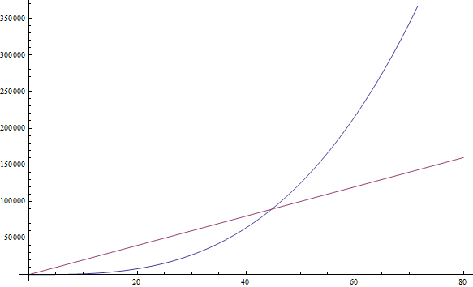
Compare functions: n³ and 1999n
The n³ function, drawn in blue, becomes larger than the 1999n function, drawn in red, after n = 45. After that point it remains larger for ever.

Slide 39
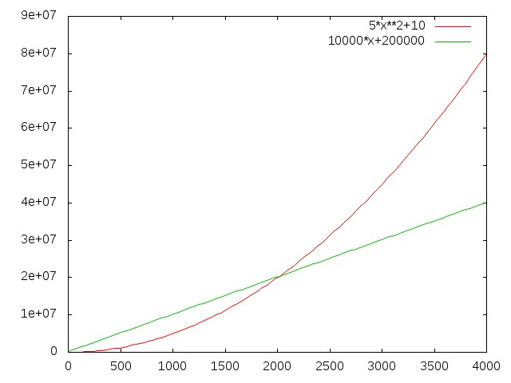
Compare functions: 5x²+10 and 10000x+200000
The 5x²+10 function, drawn in red, becomes larger than the 100000x+20000 function, drawn in blue after x = (nearly) 2000. After that point it remains larger for ever. The constants 100000 and 20000, are big but stop making a difference after a x ~=2000

Slide 40
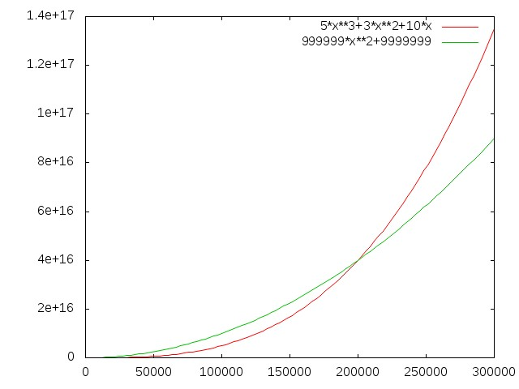
Compare functions: 5x³+3x²+10x and 999999x²+999999
The 5x³+3x²+10x function, drawn in red, becomes larger than the 999999x²+999999 function, drawn in blue after x = (nearly) 210000. After that point it remains larger for ever. The constants 999999 and 999999, are big but stop making a difference after a x ~=210000

Slide 41
Some key points
Meaning of constant
  Actual value of constants depends on
  (a) number of steps in the algorithm
  (b) speed/quality of the processor
  Changing the processor changes constants
  E.g. on a 2GHz processor, compared to a 1GHz processor, the constants will be smaller

Slide 42
3n² + 5x and 300n + 500
n³ and 1999n
5x²+10 and 10000x+200000

Slide 43
General Notes about different degree functions
We saw that a function of a different degree is altogether qualitatively different than a function of a lower degree
All functions of the same degree (differing by constants) are comparable to each other as they only differ by constants
Hence it is imperative to see the behaviour – rate of growth- of different functions

Slide 44
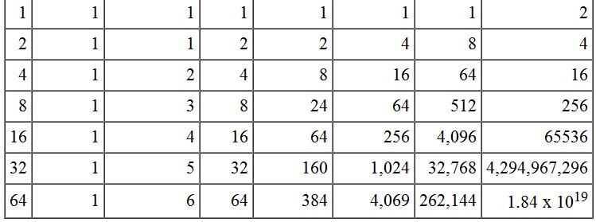
Rates of growth of various functions of n
n 1 log n n n log n n² n³ 2^{n}
https://www.cpp.edu/~ftang/courses/CS240/lectures/img/alg-tab.jpg

Slide 45
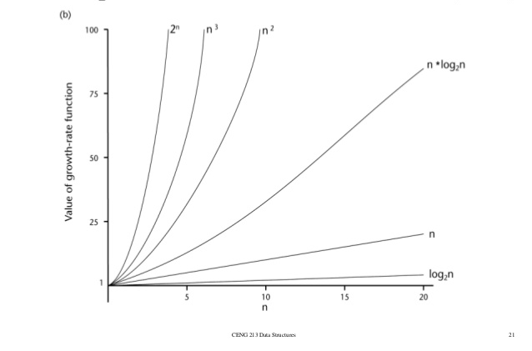
Comparison of rates of growth of various functions
http://www.slideshare.net/sumitbardhan/algorithm-analysis

Slide 46
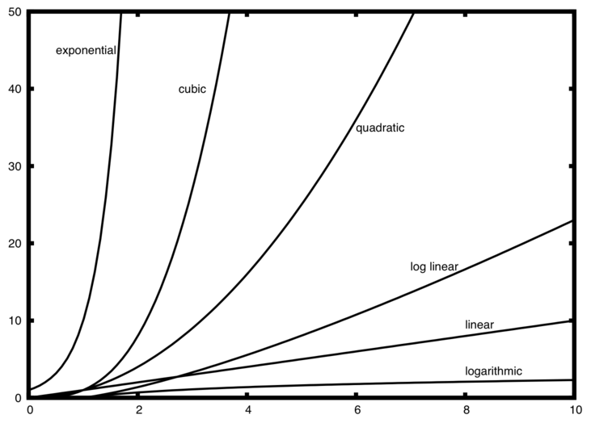

Slide 47
Rates of growth of various functions
The graph on earlier slide shows us that
  Some functions like log(n) grow very slowly while some like 2^{n} grow extremely fast
  Functions like 2^{n} or even n¹⁰ are horribly expensive

Slide 48
Comparison of functions
We find that
  The constants in equation become less significant as the “size of input” (value of n) grows
  The highest degree term in a polynomial equation will dominate other terms as value of n grows
  Even if a smaller degree equation has a very high constant, a higher degree equation with a small constant will dominate it after sufficiently high n

Slide 49
Comparison of functions
We find that
  All cn^{p} curves fall in same category and in different category than dn^{q}
    If q > p, then all dn^{q} curves will cross all cn^{p} curves sooner or later
  Due to this It is generally sufficient to know
    That a function behaves “worse” or “better” than (some multiple of) a known function (like n² ore n³ or nlogn, etc )

Slide 50
Comparison of functions
We find that
  The constants in equation become less significant as the “size of input” (value of n) grows
  The highest degree term in a polynomial equation will dominate other terms as value of n grows
  Even if a smaller degree equation has a very high constant, a higher degree equation with a small constant will dominate it after sufficiently high n

Slide 51
Comparison of functions
We find that
  All cn^{p} curves fall in same category and in different category than dn^{q}
    If q > p, then all dn^{q} curves will cross all cn^{p} curves sooner or later
  Due to this It is generally sufficient to know
    That a function behaves “worse” or “better” than (some multiple of) a known function (like n² ore n³ or nlogn, etc )

Slide 52
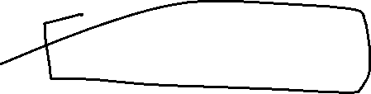

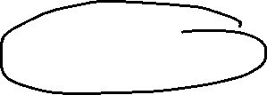



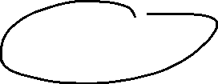



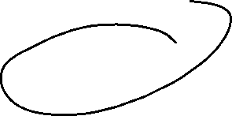

Asymptotic Notations
Asymptotic Notations are mathematical notations used to describe the running time of an algorithm
Following are the commonly used Asymptotic Notations to calculate the running time complexity of an algorithm.
Ο Notation (Big ‘Oh’ )
Ω Notation (Omega)
θ Notation (Theta)

Slide 53

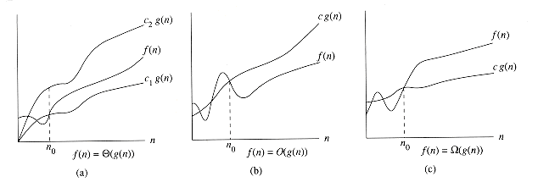
Meaning of O, Ώ and Ɵ notation
f(n) = Ɵ(g(n)) means that f(n) is bound on the upper and lower sides by some multiples of the function g(n)
f(n) = O(g(n)) means that f(n) is bound on the upper side by some multiple of the function g(n)
f(n) = Ώ(g(n)) means that f(n) is bound on the lower side by some multiple of the function g(n)
http://staff.ustc.edu.cn/~csli/graduate/algorithms/book6/chap02.htm

Slide 54
Big Oh Notation, Ο
The notation Ο(n) is the formal way to express the upper bound of an algorithm's running time. It measures the worst case time complexity or the longest amount of time an algorithm can possibly take to complete.

Slide 55
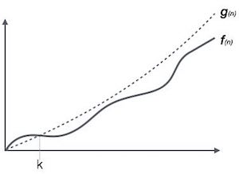
O notation

Slide 56
O notation
For example, for a function f(n)
Ο(f(n)) = { g(n) : there exists c > 0 and n₀ such that f(n) ≤ c.g(n) for all n > n₀ }
Big O of f(n) is bigO of g(n) iif there exist positive constant c and n₀ such that f(n)<cg(n) for all n, n>=n₀

Slide 57
O notation
Find a function, whose constant multiple, is worse than the given function
f(x) = O(g(x)) if and only if there exists a positive real number C and a real number x0 such that
| f ( x ) | ≤ C | g ( x ) | for all x ≥ x 0

Slide 58
O notation
For example
If f(x) = 2x² + 10
Then
  Since f(x) <= 13x² whenever x>=1
  f(x) = O(x²)
  here c = 13 and x0 = 1, and g(x) = x²

Slide 59
  Also, we can say
  f(x) <= 3x³, whenever x >=10
  So f(x) = O(x³) is also true
  Here c = 3, x0 = 10, g(x) = x³
Finding the c, x0 and g(x) can be done by trial/error, intelligent guess, or using algebra

Slide 60
O notation
O notation is called “upper bound”
We always try to find an upper bound which is as low as possible
In the earlier example we have shown that f(x) = O(x²)
Can we show f(x) = O(x)?
  Let’s try. Suppose f(x) = O(x)
  Then it means f(x) <= cx for some c and when x>=x0
  ==> 2x² + 1 <= cx
  ==> 2x² -cx + 1 <= 0
  ==> x (2x - c) + 1 <=0
  ==> x <= -1/(2x-c)
  Now as x grows, -1/(2x-c) can only get smaller so above condition is impossible
  Which means f(x) = O(x) is not possible
  So the lowest upper bound we can get is f(x) = x²

Slide 61
f(n) = 3n + 2
f(n) = O(n)
3n+2 <= 4n
100n + 200 <= 301n => O(n)
10n² + n + 50 <= 61n²
O(n²)

Slide 62
f(n) = 2n+3
g(n) = 3n
O(g(n)) = n
g(n) = n² + n
O(g(n)) = n²
//This is not the tightest / closest upper bound

Slide 63
Omega Notation, Ω
The notation Ω(n) is the formal way to express the lower bound of an algorithm's running time. It measures the best case time complexity or the best amount of time an algorithm can possibly take to complete.

Slide 64
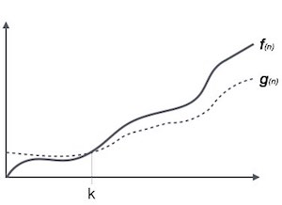

Slide 65
For example, for a function f(n)
Ω(f(n)) ≥ { g(n) : there exists c > 0 and n0 such that g(n) ≤ c.f(n) for all n > n0. }

Slide 66
Ώ notation
Find a function, whose constant multiple, is worse than the given function
f(x) = Ώ (g(x)) if and only if there exists a positive real number C and a real number x0 such that
f ( x ) >= C g ( x ) for all x ≥ x 0
For example
  If f(x) = 2x² + 10
  Then
  Since f(x) >= x² whenever x>=1
  f(x) = Ώ(x²)
  here c = 1 and x0 = 1, and g(x) = x²
  Also, we can say
  f(x) >= 3x, whenever x >=0
  So f(x) = Ώ(x) is also true
  Here c = 3, x0 = 0, g(x) = x

Slide 67
Ώ notation
Ώ notation is called “lower bound”
We always try to find a lower bound which is as high as possible
In the earlier example we have shown that f(x) = Ώ(x²) and f(x) = Ώ(x) also
Can we show f(x) = Ώ(x³)?
  Let’s try. Suppose f(x) = Ώ(x³)
  Then it means f(x) >= cx³ for some c and when x>=x0
  ==> 2x² + 1 >= cx³
  ==> 0 >= cx^{3 –} 2x²⁻ 1
  ==> 1 >= x² (cx - 2)
  ==> 1/(cx-2) >= x²
  Now as x grows, 1/(cx-2) can only get smaller so above condition is impossible
  Which means f(x) = Ώ(x³) is not possible
  So the highest lower bound we can get is f(x) = Ώ(x²⁾

Slide 68
Big Omega : Ω
f(n) = 3n+2
g(n) = n
f(n) = Ω g(n)
f(n) >= c g(n) { c>=1 and n0 >=1}
3n+2 = Ω(n)

Slide 69
f(n) =3n +2
g(n) = n ²
3n +2 = Ω(n ²) (Is this true?)

Slide 70
3n +2 >= cn ²
(Not possible)

Slide 71
f(n) = n² +n +2 = Omega(n) ??

Slide 72
Theta Notation, θ
The notation θ(n) is the formal way to express both the lower bound and the upper bound of an algorithm's running time. It is represented as follows −

Slide 73
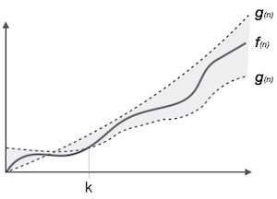

Slide 74
θ(f(n)) = { g(n) if and only if g(n) = Ο(f(n)) and g(n) = Ω(f(n)) for all n > n0. }

Slide 75
f(n) = 3n + 2
g(n) = n
f(n) <= c g(n) { c >3} : f(n) = O(g(n))
f(n) >= c g(n) { c<3 } : f(n) = Ω(g(n))

Slide 76
Ɵ notation
f(n) = Ɵ ( g(n))
If
k 1 ⋅ g ( n ) ≤ f ( n ) ≤ k 2 ⋅ g ( n )
for some positive k1, k2
In short we can say that
if f(x) = O(g(x))
and f(x) = Ώ(g(x))
then f(x) = Ɵ(g(x))

Slide 77
General rule for polynomials
Try proving this
If
P(x) = a_{n} x^{n} + a_{n-1} x^{n-1} + .... + a₁x + a₀
Then
P(x) = O(x^{n} )
P(x) = Ώ (x^{n} )
And P(x) = Ɵ(x^{n} )
So if
P(x) = 2x⁴+3x²+10
then
P(x) = O(x⁴)
P(x) = Ώ (x⁴)
P(x) = Ɵ(x⁴)

Slide 78
Time complexity analysis of some algorithms

Slide 79
Consider the factorial function
The time taken by this code is
  T(n) = An + B
  As the loop runs n times, and loop body has constant time A
  B = constant time required for non-loop code & i=1
Since this is polynomial equation
  T(n) = O(n)
  T(n) = Ɵ(n) also
This means
  The factorial function always runs tightly bound by the linear function
unsigned int fact(unsigned int n) {
int i, sum = 1;
for(i = 1; i <= n ; i++)
sum *= i;
return sum;
}

Slide 80
Consider the linear search function
int linearsearch(int *a, int n, int x ) {
int h, l;
l = 0;
h = n - 1;
while(l <= h) {
if(a[l] == x)
return l;
if(a[l] > x)
return -1;
l++;
}
return -1;
}
This code does not always run in the same fashion
Depending on the input the code may run some steps and skip some
For example
  If x was a[0], then then code will only enter the loop and return
  If x was a[3], then the code will run 3 loops
  If x was not in the array, then the code may return from the return -1 inside the loop
  Etc.
Problem: given a sorted array a, array length n, and a search element x, find the location of x in the array, return -1 otherwise

Slide 81
Consider the linear search function
int linearsearch(int *a, int n, int x ) {
int h, l;
l = 0;
h = n - 1;
while(l <= h) {
if(a[l] == x)
return l;
if(a[l] > x)
return -1;
l++;
}
return -1;
}
For such code we find three different equations
  Worst case
    This is the equation for the case when code runs maximum number of steps
  Best Case
    This is the equation for the case when code runs minimum number of steps
  Average case
    This is the equation representing average time considering all possible ways in which the code can run

Slide 82
Consider the linear search function
Worst case
  Worst case has to be found by observing the code.
  Here, worst case occurs when x > a[n-1]
  In worst case, the loop runs n times and finally the last “return -1” is executed
int linearsearch(int *a, int n, int x ) {
int h, l;
l = 0;
h = n - 1;
while(l <= h) {
if(a[l] == x)
return l;
if(a[l] > x)
return -1;
l++;
}
return -1;
}

Slide 83
Consider the linear search function
Worst case
  The time taken in worst case, therefore, is
  T_{w}(n) = An + B
  Where A = time taken inside loop
  B = time taken outside loop
So
T_{w}(n) = Ɵ(n)
int linearsearch(int *a, int n, int x ) {
int h, l;
l = 0;
h = n - 1;
while(l <= h) {
if(a[l] == x)
return l;
if(a[l] > x)
return -1;
l++;
}
return -1;
}

Slide 84
Consider the linear search function
Best case
  Best case has to be found by observing the code.
  Here, best case occurs when x is a[0]
  In best case, we only run
  l = 0;
  h = n – 1;
  l <=h condition
  a[0 ] == x condition and
  return 0 ;
int linearsearch(int *a, int n, int x ) {
int h, l;
l = 0;
h = n - 1;
while(l <= h) {
if(a[l] == x)
return l;
if(a[l] > x)
return -1;
l++;
}
return -1;
}

Slide 85
Consider the linear search function
int linearsearch(int *a, int n, int x ) {
int h, l;
l = 0;
h = n - 1;
while(l <= h) {
if(a[l] == x)
return l;
if(a[l] > x)
return -1;
l++;
}
return -1;
}
Best case
  The time taken in best case, therefore, is
  T_{b}(n) = C
  Where C = Constant
So
T_{b}(n) = Ɵ(1)

Slide 86
Consider the linear search function
int linearsearch(int *a, int n, int x ) {
int h, l;
l = 0;
h = n - 1;
while(l <= h) {
if(a[l] == x)
return l;
if(a[l] > x)
return -1;
l++;
}
return -1;
}
Average case
  Average case analysis is often quite complicated as it involves finding out all possible ways in which the code runs
  In how many possible ways the given code runs?

Slide 87
Consider the linear search function
Average case
  If we focus on the fact that the function has to return, then it returns in following possible ways
    n ways to return with a[l] == x true
      That is x found
    n ways to return with
    a[l] > x true
      That is x not found
    1 way to return with -1 in the end (x not found)
  Total 2n+ 1 ways to return
int linearsearch(int *a, int n, int x ) {
int h, l;
l = 0;
h = n - 1;
while(l <= h) {
if(a[l] == x)
return l;
if(a[l] > x)
return -1;
l++;
}
return -1;
}

Slide 88
Consider the linear search function
Average time for linear search = (sum of time required for 2n+1 ways in which code can run) / (2n + 1)
Total time taken in returning with a[l] ==x true:
= (c) + (c + b) + (c + 2b) +... (c+(n-1)b)
Here
c: time required to run l=0; h = n -1; condition l<=h; condition a[l] == x (on success) and return x (on success)
b: time required to run if(a[l] > x) condition; l++; condition l<=h on unsuccessful run of loop
Here c: time required when a[0] == x
c + b: time required when a[1] == x
and so on

Slide 89
Consider the linear search function
Total time taken in returning with a[l] > x as true:
= (e) + (e + d) + (e + 2d) +... (e+(n-1)d)
Here
e: time required to run l=0; h = n -1; condition l<=h; condition a[l] > x and return -1
d: time required to run (a[l] == x) condition; (a[l] > x) condition; l++; condition l<=h on unsuccessful run of loop
Time taken when x > a[n-1]
= An + B

Slide 90
Average time for linear search = (sum of time required for 2n+1 ways in which code can run) / (2n + 1)
= ( (c+(c+b)+(c+2b)+...(c+(n-1)b)
+ (e+ (e+d)+(e+2d)...(e+(n-1)d)
+ An + B )
/ (2n+1)
= ( n (c + e + A) + (b + d) (1 + 2 + ... (n-1)) + B )/ (2n + 1)
= (Pn + Q(n-1)n/2 + B ) / (2n + 1)
Here the numerator is a quadratic equation in ‘n’ and denominator is linear equation in ‘n’ so the equation is nearly same as
= Xn + Y + Z/n
Which is a linear equation.

Slide 91
Consider the linear search function
So average case time for linear search is
T_{a}(n) = Xn + Y + Z/n
= Ɵ(n)

Slide 92
Consider sine(x) code
double sine(double x) {
int n;
double sum, term;
n = 3;
sum = x;
term = x;
while(isgreater(fabs(term), 0.0000000001)) {
term = (term * x * x) / ( n * (n -1));
if(n % 4 == 3)
sum -= term;
else
sum += term;
n = n + 2;
}
return sum;
}
Here although we have an if-else code, both the if and else parts take same time
So we don’t have a worst/average/best case scenario here
We only need to find one equation

Slide 93
Consider sine(x) code
double sine(double x) {
int n;
double sum, term;
n = 3;
sum = x;
term = x;
while(isgreater(fabs(term), 0.0000000001)) {
term = (term * x * x) / ( n * (n -1));
if(n % 4 == 3)
sum -= term;
else
sum += term;
n = n + 2;
}
return sum;
}
Here the crucial question is how many times does the loop run?
This is not so easy to answer and will involve analysing the Taylor’s series and the loop conditions
Take this as a homework

Slide 94
Homework: Binary search
int binarysearch(int *a, int n, int x ) {
int l, h, m;
l = 0;
h = n - 1;
while(l <= h) {
m = (l + h) / 2;
if(a[m] == x)
return m;
else if(a[m] < x)
l = m + 1;
else
h = m - 1;
}
return -1;
}
Do the worst, best, average case analysis of binary search.

